Slide 1
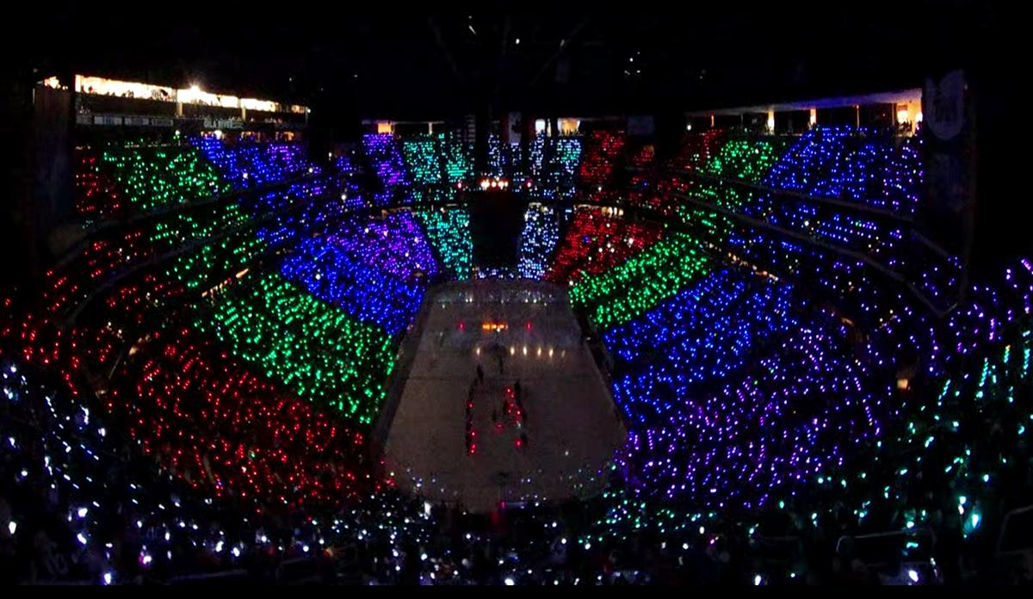
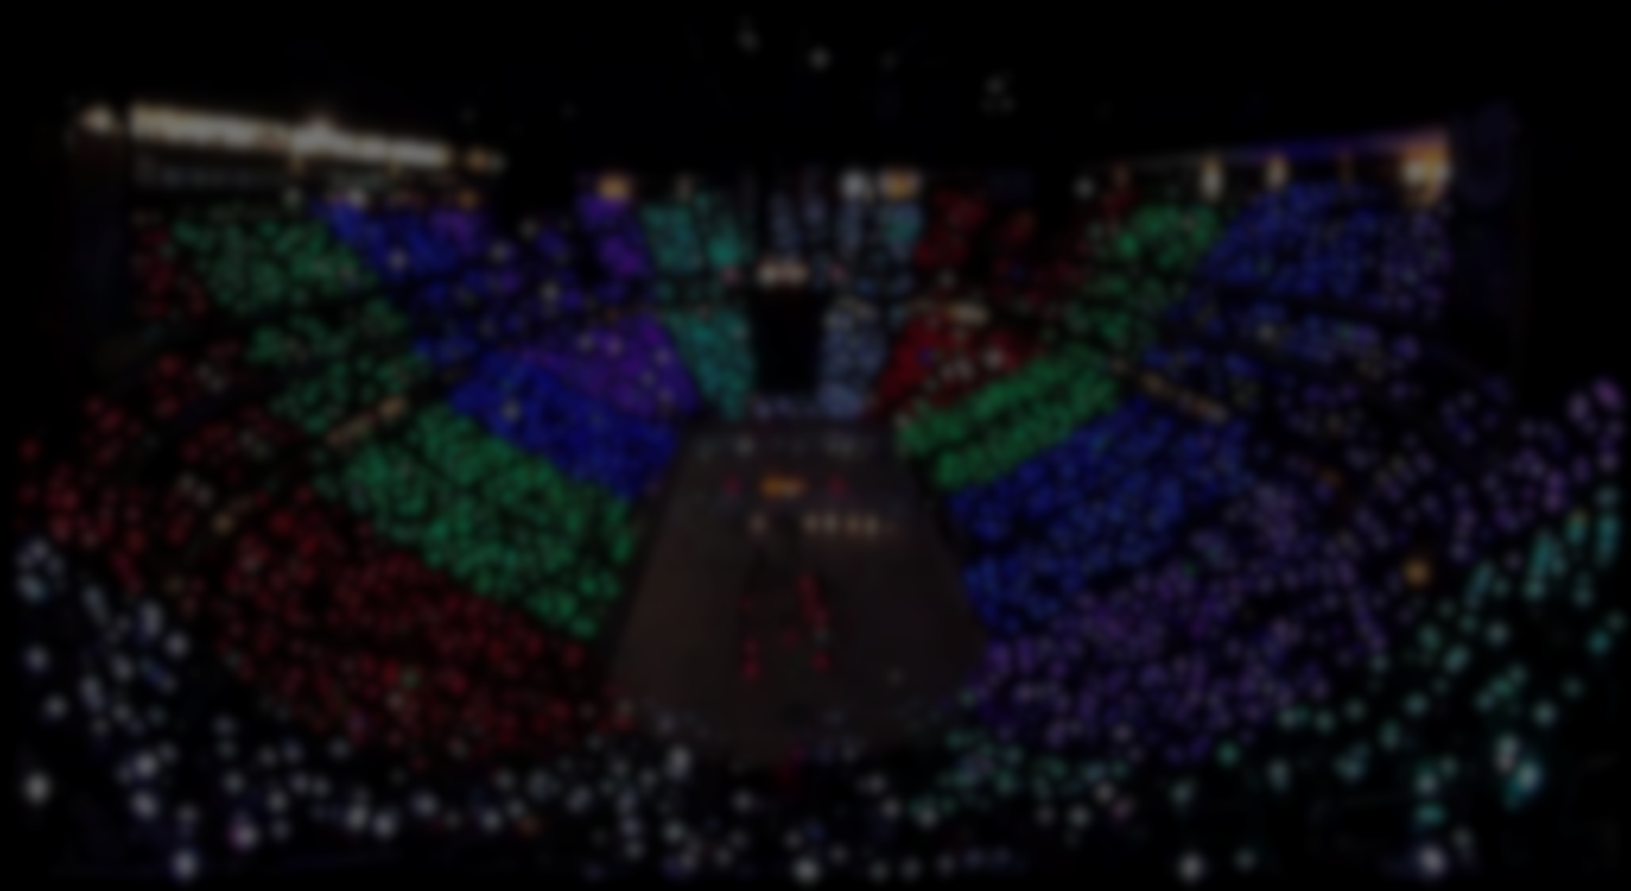
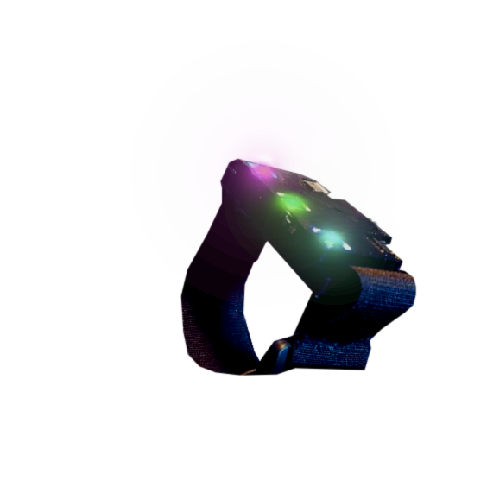
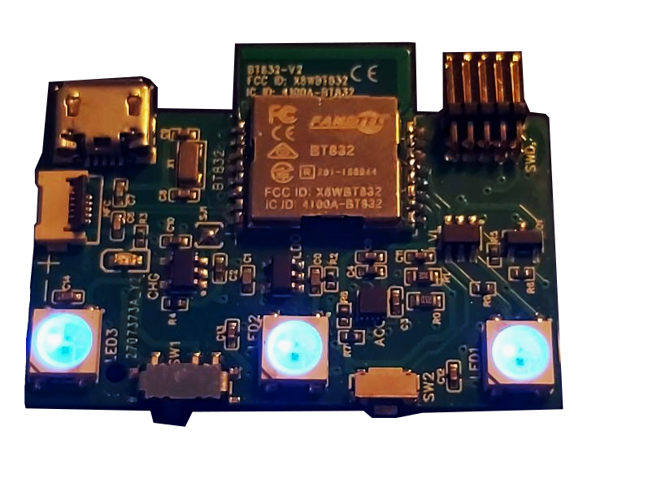
Wireless LED Bracelet
Group 4: Ethan Eger Carter Laube Elijah Madsen Hunter Whyte

Slide 2
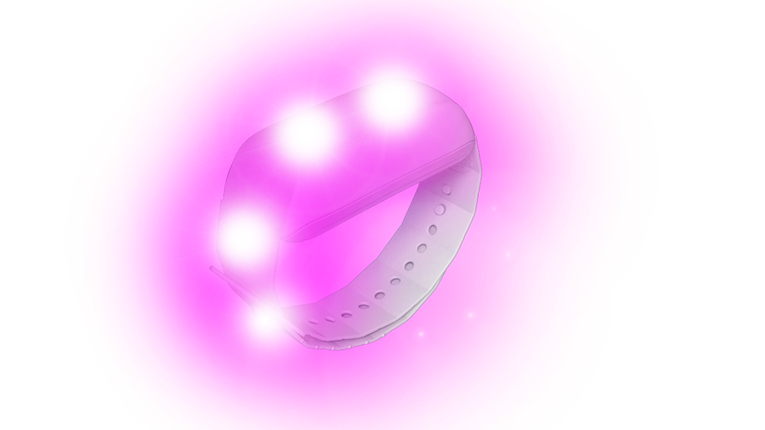
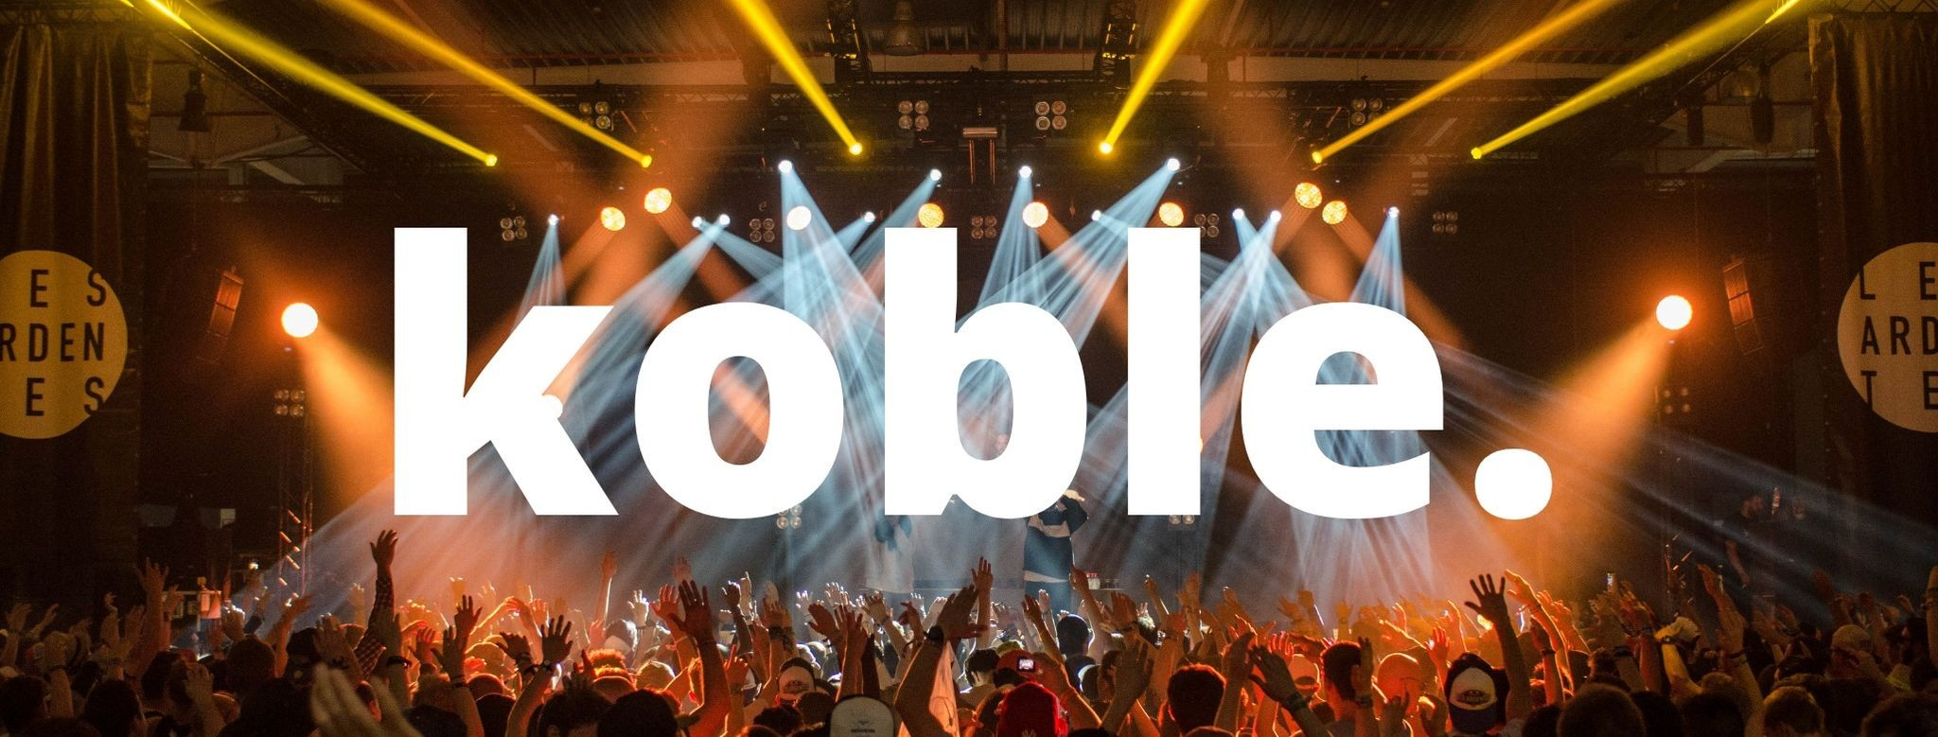
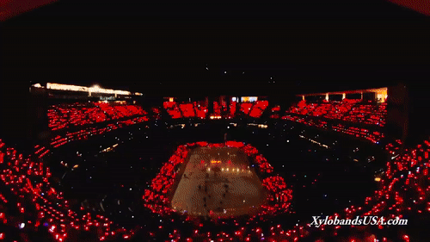
Problem Description
Audience members wear bracelets with lights controlled wirelessly by venue
Controlled in groups to create light shows for live events
Notes:
Elijah 20s
Proposed by a company called koble who is developing an app for finding concerts, buying tickets.
Bracelet or wristband with LEDs to be worn at live events.
These bracelets are given out at the beginning of the event and controlled wirelessly by the lighting technicians to create light shows for live events.
In synch with music like in gif

Slide 3
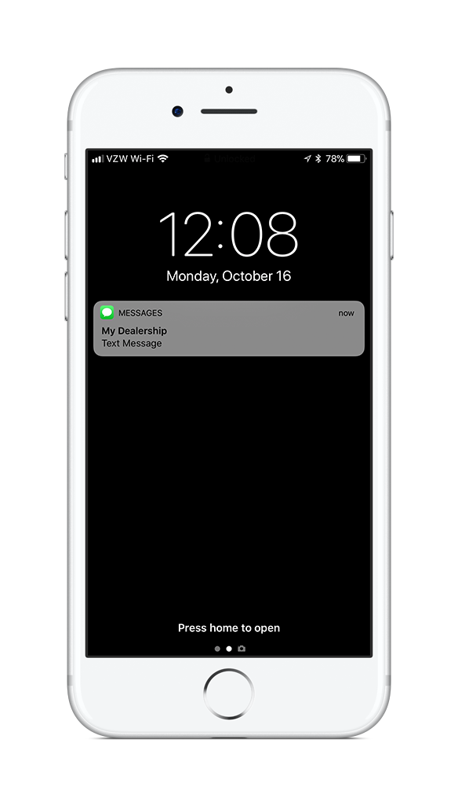
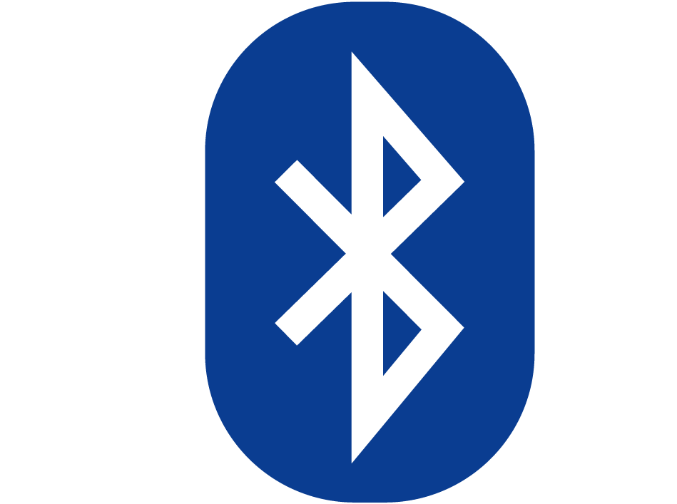
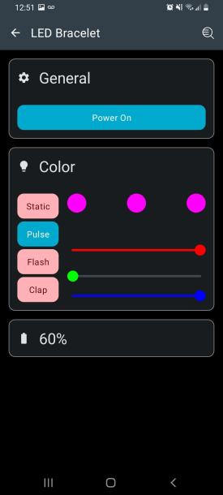
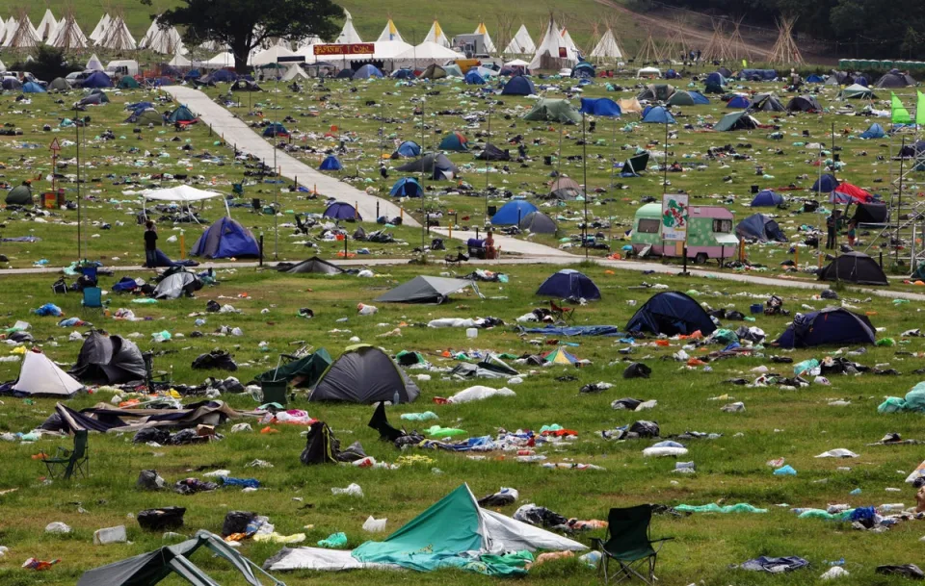
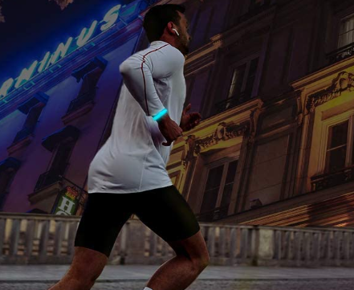
Problem Description
Our proposed project:
Attendees keep bracelets after event
Rechargeable battery
Connects to phones for use outside of venue
Bring your bracelet to the next event!
Existing products:
Organizers attempt to collect from attendees after event
Reused and given out at next event
Single-use battery
“Festivals are facing mounting pressure to clean up their act, lower emissions and cut down on waste” - CNN, 2019
“In recent years, major festivals have stepped up their efforts to tackle waste.” - Yahoo news, 2022
Notes:
Elijah 45s
Lots of existing products
Single use battery, given out at start of the event, not supposed to take home.
Anecdotal evidence if you look on the internet of people keeping bracelets or throwing them away. Some people claiming that the majority of wristbands are not collected and reused
Raises environmental concern of creating e-waste with these bracelets, environmental issues are increasingly important to event organisers these days.
Our product is reusable rechargeable
Attendees keep them after event
Connects to phone for use outside of venue
So that people understand what would need to be supported as possible use cases for outside of concerts. Bracelet lighting up when you get a phone notification, wear it on a run at night so cars can see you.

Slide 4


Physical Requirements
Rechargeable batteries
Battery life of at least 3.5 hours
Tri-colour LEDs
Motion detection
Notes:
Carter
Rechargeable: for re-use at future concerts and personal use
RGB LEDs so we can do any color
Capable of detecting movement: waves and claps will trigger light effects

Slide 5
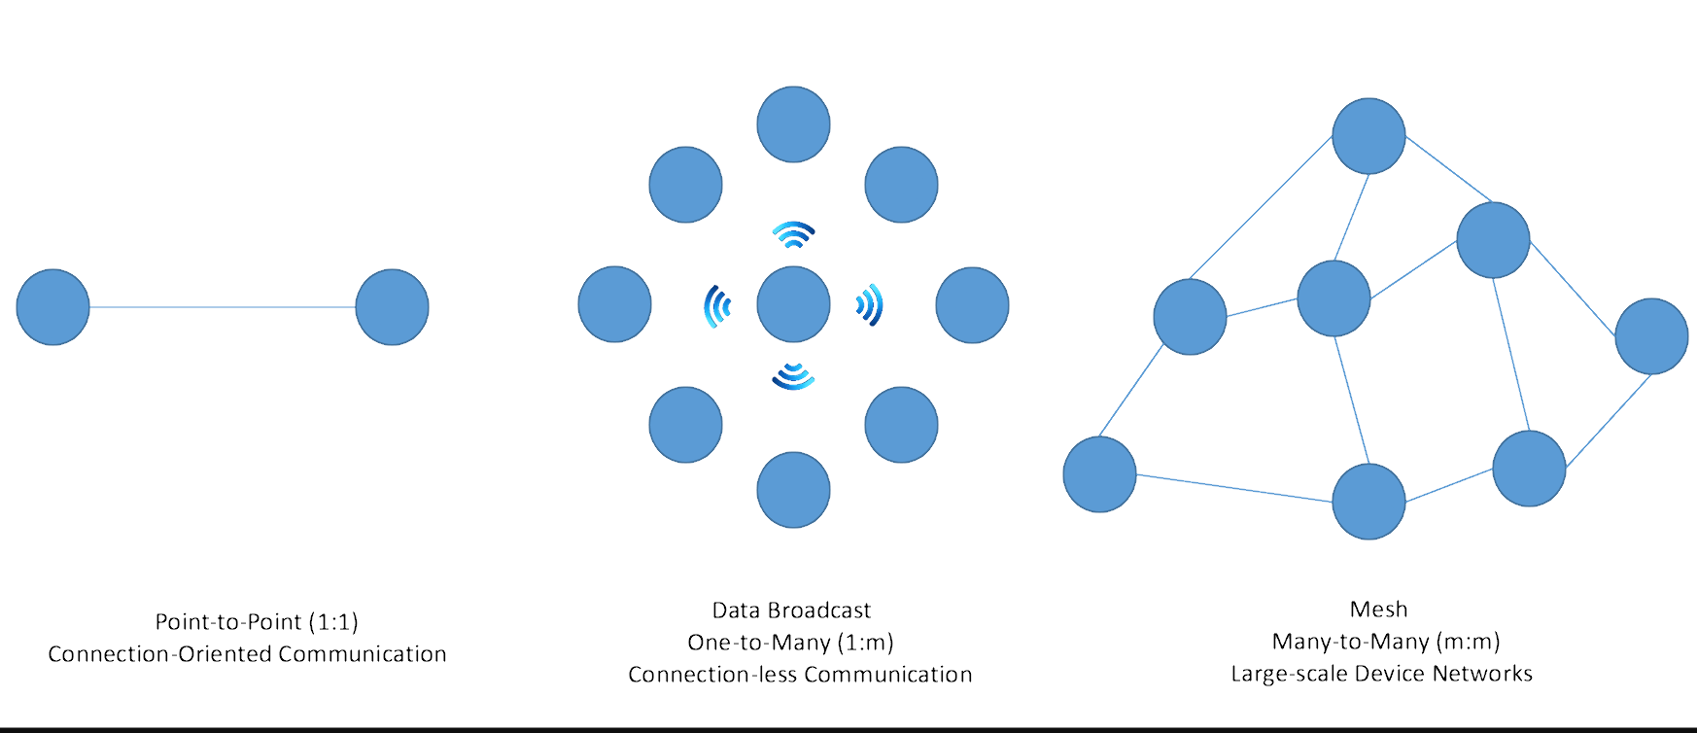
Connectivity Topology Requirements
Two wireless control sources required
Bidirectional connection to smartphones using Bluetooth 4.0 (BLE)
2. Unidirectional broadcast from central controller to bracelets
Must be able to control 32 individually addressable groups
Notes:
Ethan
Communication with the smartphone outside of concerts need BLE.
To have all bracelets work in sync we need to unidirectional broadcast from the central controller.
Bracelet can be controlled by phone over bluetooth outside of concert
BLE connections are always bidirectional so the bracelet is sending and receiving to the phone.
Bracelet is controlled by the central system being run by lighting techs at venue
Support 32 individually addressable groups - one section of ppl is one color
Support for 25,000 bracelets total
Bracelets have nothing that they send back to the central system - central system can just broadcast - bracelets do not have to transmit

Slide 6


Central Controller Wireless Requirements
Maximum latency between controller and bracelets of 100ms
Minimum refresh rate of 10Hz
75m range
RGB565 Colour resolution
Refresh rate comparison
RGB565 gradient
2.5Hz
5Hz
10Hz
Notes:
Ethan
100ms latency
10Hz refresh rate was determined experimentally
75m range
full color

Slide 7
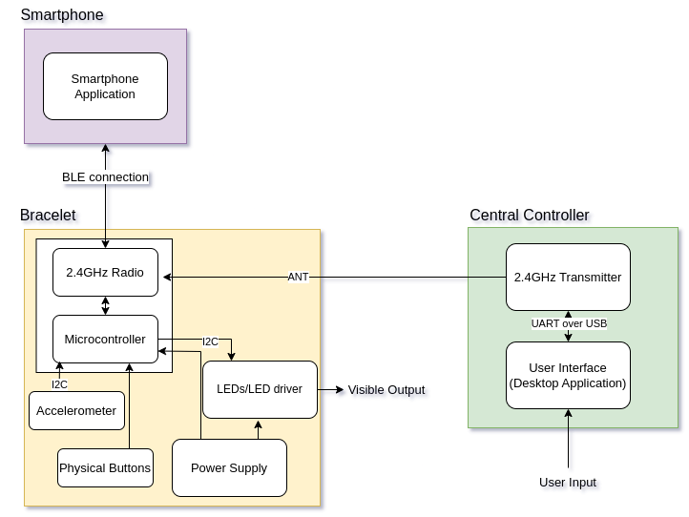
System Design
Bracelet has 2.4GHz radio SoC module for Bluetooth and communication with central controller
Central controller has 2.4GHz transmitter and is controlled through a desktop app
Notes:
Hunter
Moving on to our system design and prototype
What we settled on for our design is
For the bracelet we are using a SoC with 2.4GHz radio alongside a microcontroller for BLE connection with a smartphone
And that same 2.4GHz antenna is reused for the connection with the central controller.
The central controller has a 2.4GHz transmitter and is controlled via a desktop application

Slide 8

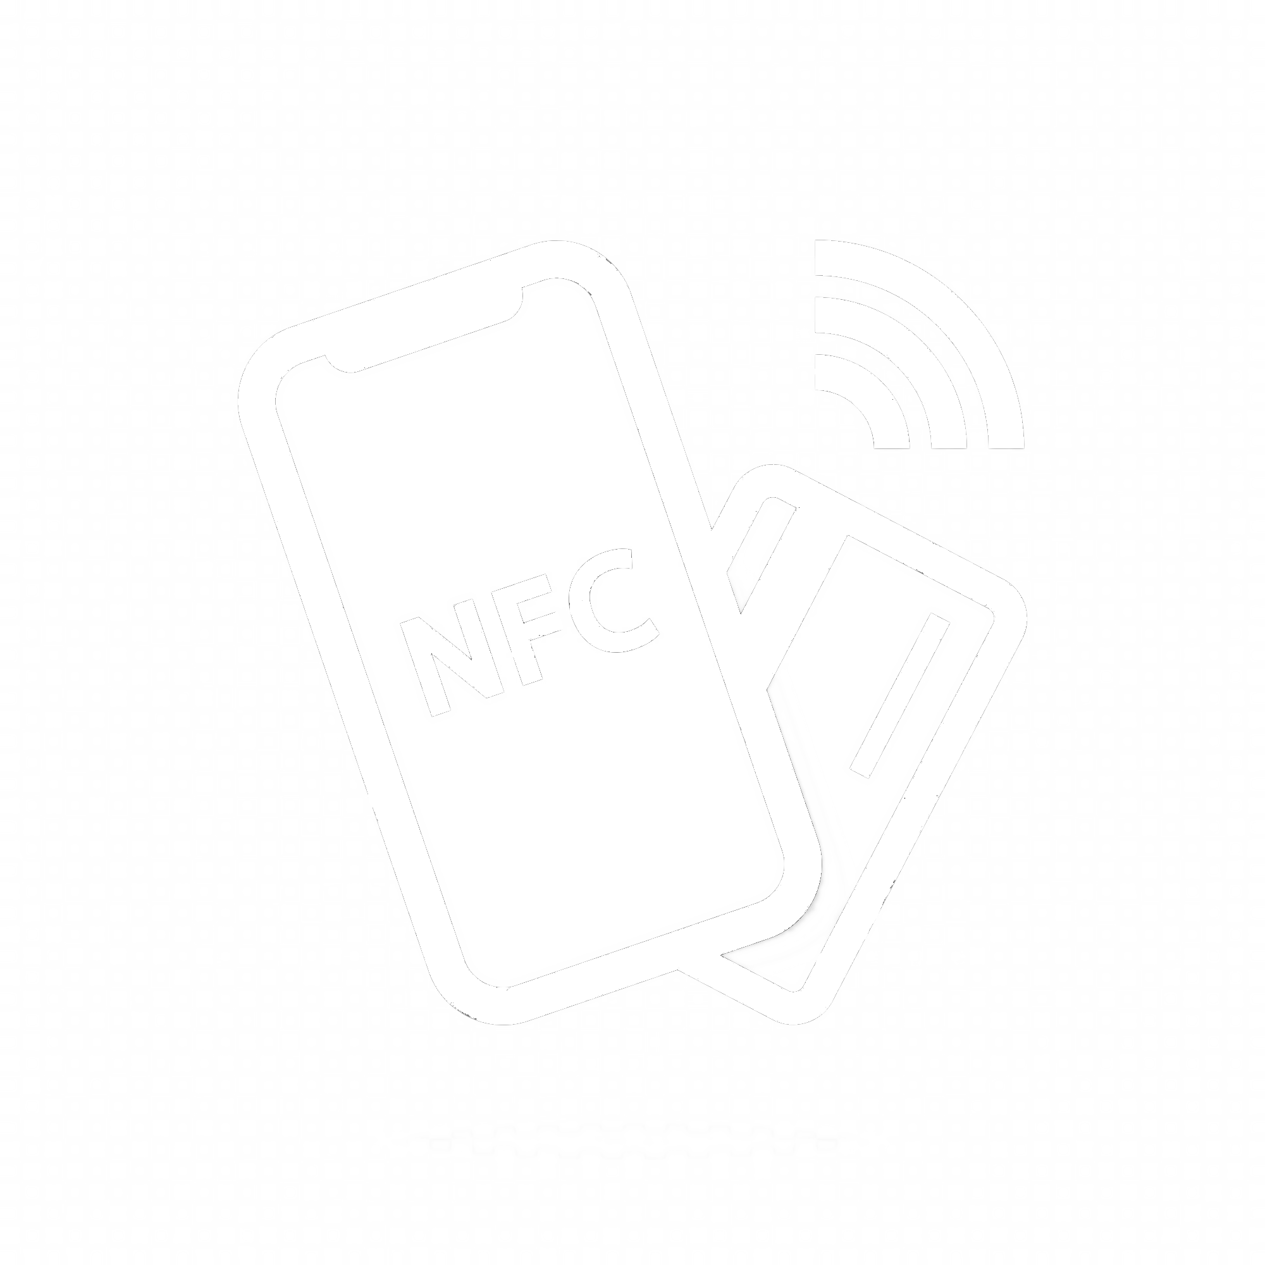
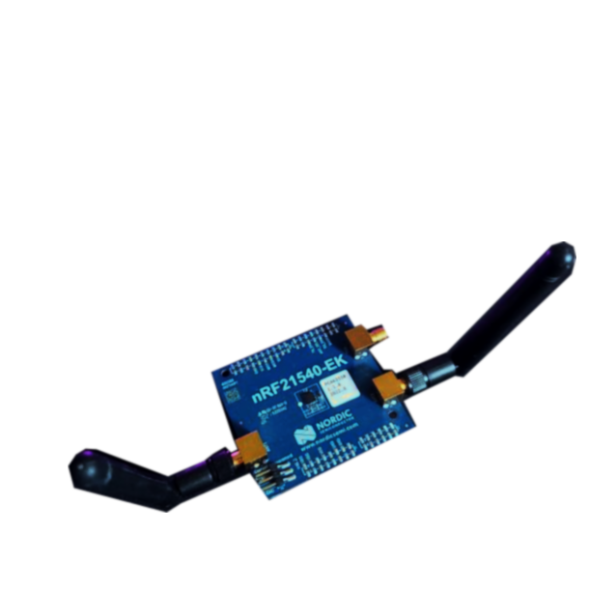
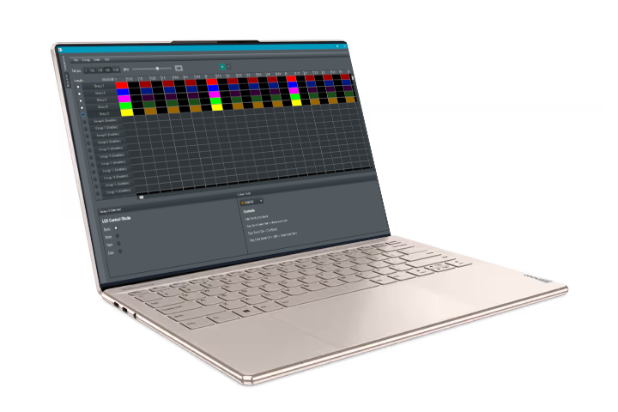
Wireless Protocols
Bluetooth Low Energy
bidirectional smartphone to bracelet
ANT
broadcast from central controller to bracelet
NFC
group assignment written over NFC
Notes:
Hunter
BLE - needed to interact with the smartphone app
ANT - earlier we mentioned 32 different groups max, so that different sections of the venue. So the central controller broadcasts on all these different ANT channels and then the bracelet depending on the group that it is assigned listens to a specific ANT channel.
NFC - also using NFC, at the moment it is just used to assign group, could potentially be used for other stuff

Slide 9
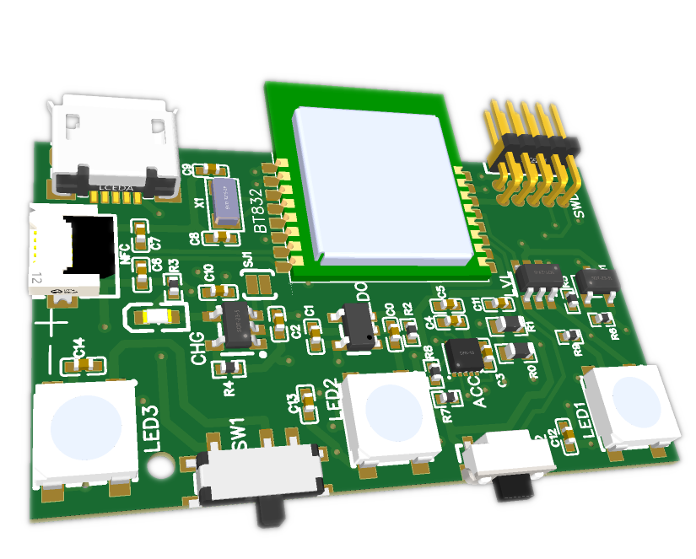
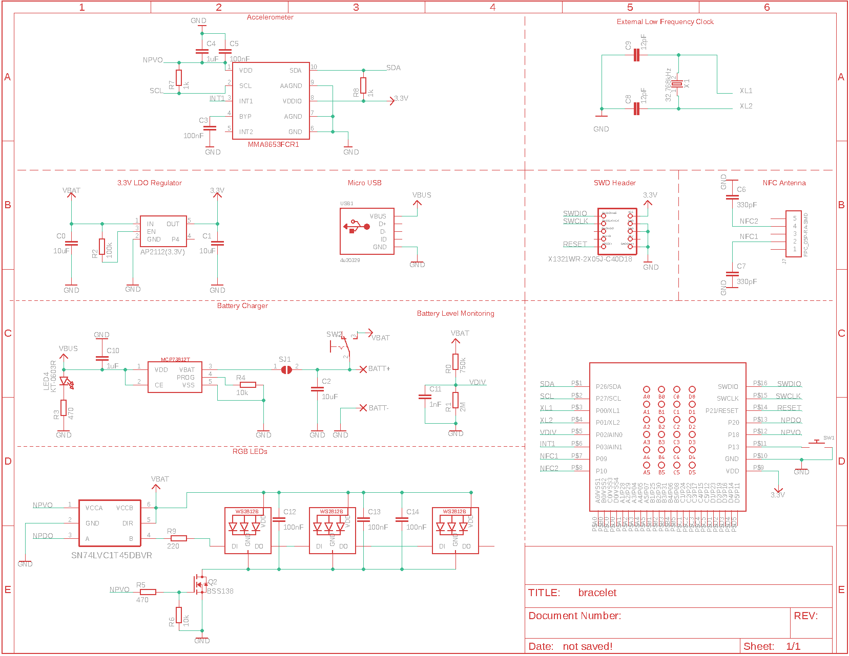

Bracelet Prototype
Notes:
Ethan
Moving on to our hardware design we made form factor prototype
3D printed mockup case
Prototype was close to form factor PCB both designed and assembled
3D printed mockup case

Slide 10
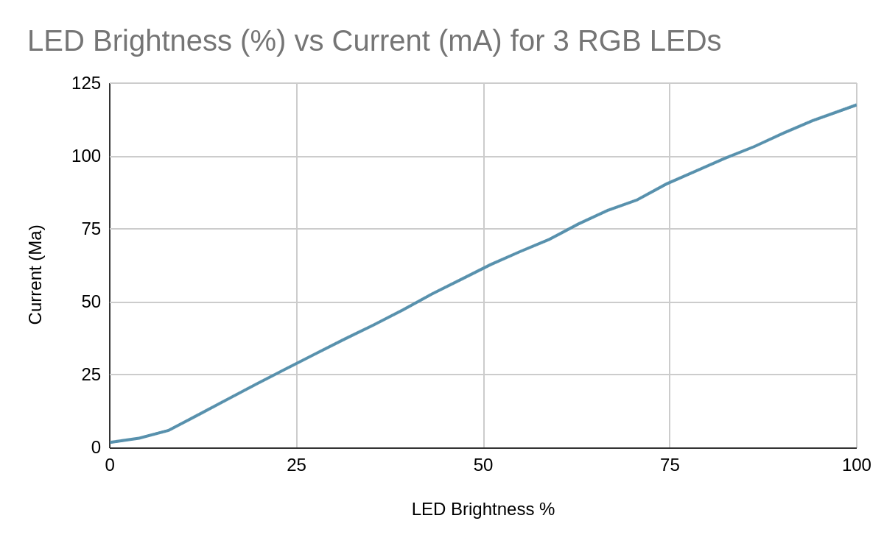
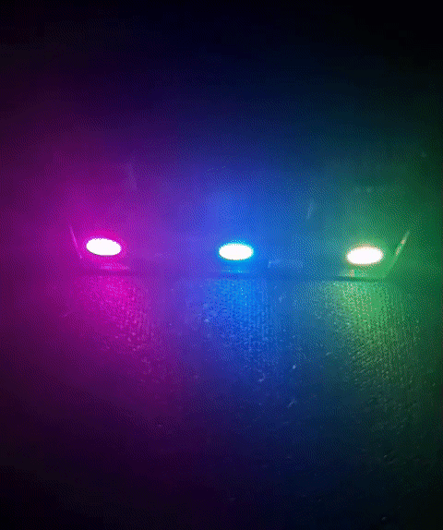
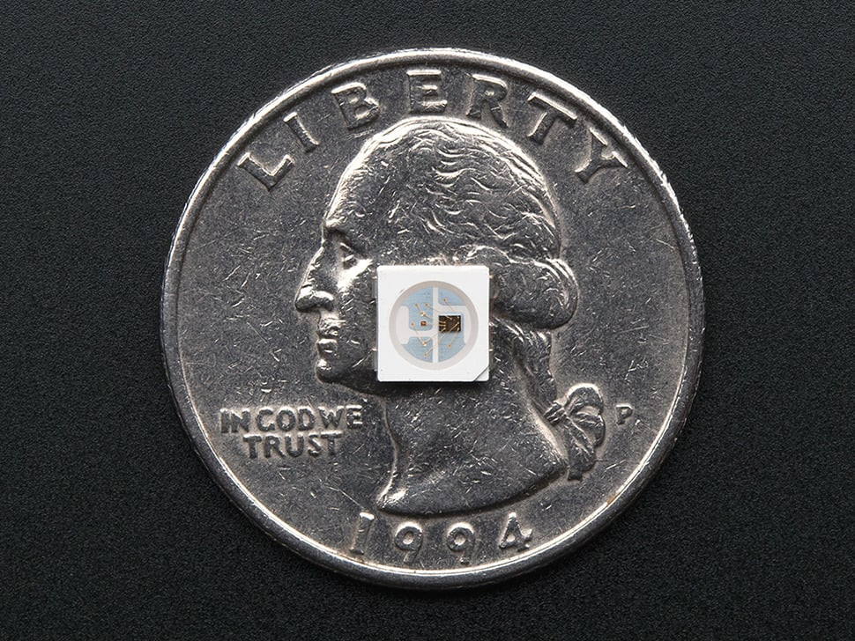
RGB LEDs: WS2812B
3x SMD 5050 RGB LEDs with integrated drivers
Individually controllable by main SoC
Notes:
Ethan
3 SMD 5050 RGB LEDs with integrated drivers
1 pin output from SoC can individually control all three LEDs
max current consumption of all three combined is ~110mA

Slide 11
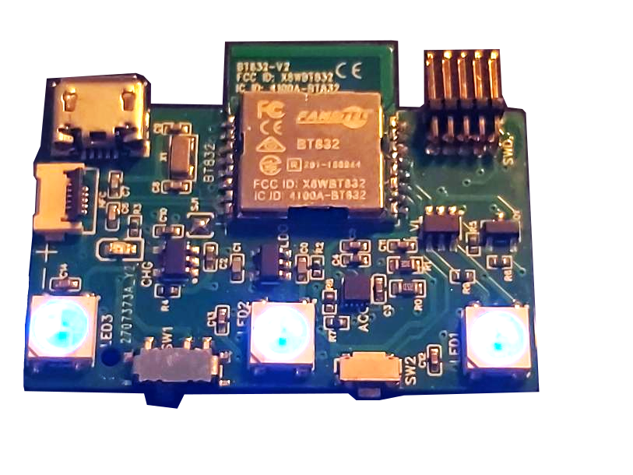
Bracelet SoC
nRF52832 selected for prototype
Supports ANT, NFC, and BLE
Module format available from multiple vendors
Subsystem | Connection
Smartphone | BLE
Central controller | ANT
Power supply | 3.3V LDO
Accelerometer | I2C
Physical button | GPIO
RGB LEDs | custom async protocol
Notes:
Hunter
this is the SoC that we selected for our design its an nrf52832
it has support for ANT, NFC, BLE
we used a module so that we didn’t have to do the PCB antenna stuff ourselves
this module is also FCC certified so you can

Slide 12
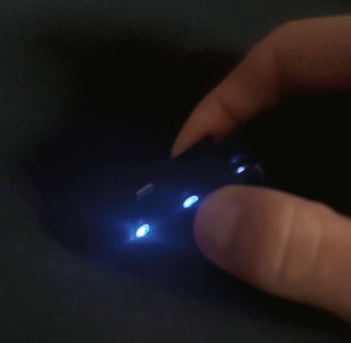
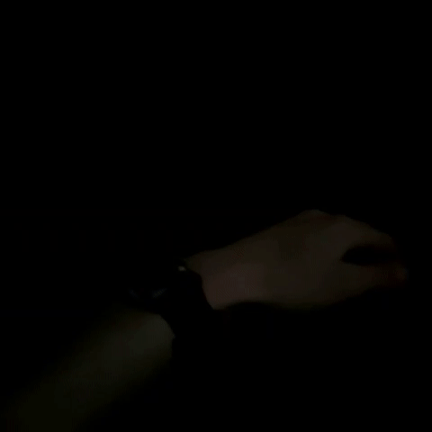
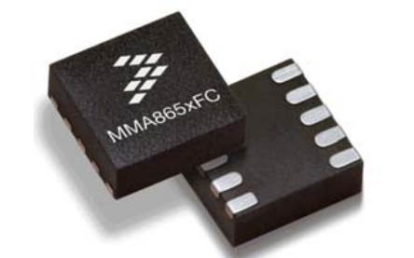
Button for manually cycling through preset modes when not connected to central controller or phone
on/off switch
Accelerometer for lighting effects based on bracelet motion (detects claps, hand waving)
Notes:
Carter
On/off switch
button for cycling through LED patterns
accelerometer onboard for motion based effects
(demo)

Slide 13
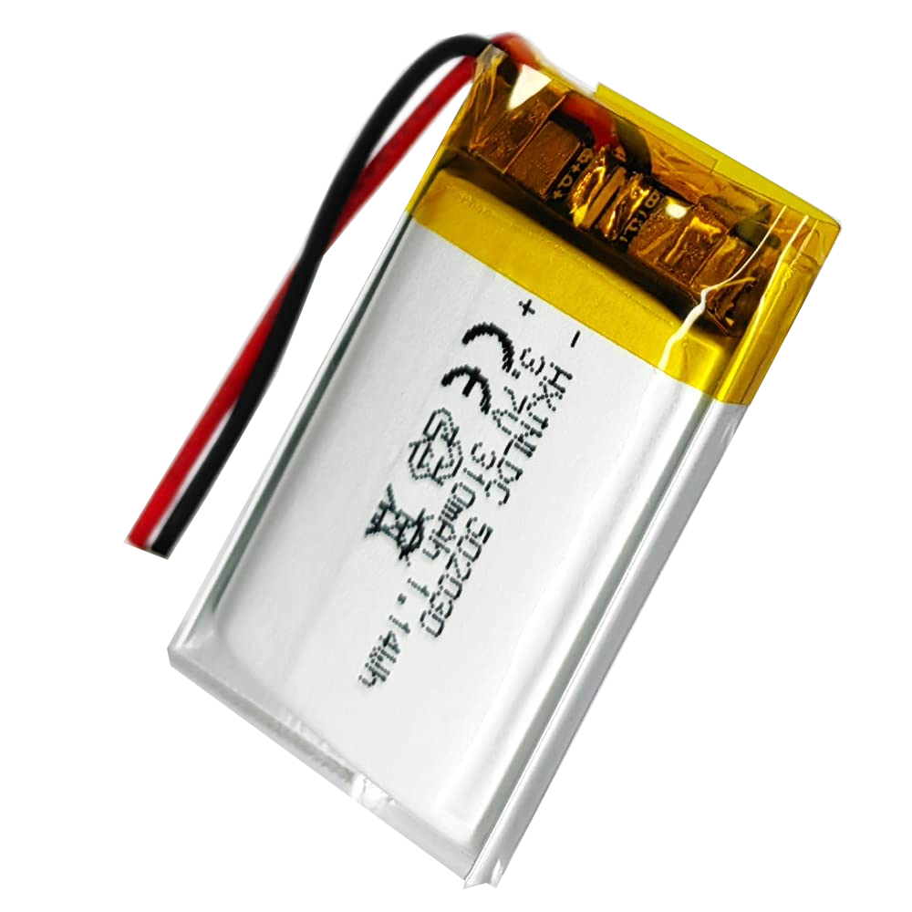
Power
310 mAh Lithium Polymer Battery 3.7V nominal voltage
Micro USB charging
Battery level monitored by main SoC
LEDs powered directly by battery 3.6V-4.2V
SoC and accelerometer powered by 3.3V LDO regulator
Notes:
Carter
battery selection - mention how we originally calculated it out for a much larger 600mAh battery power based on datasheet values.
but actual power consumption measurements were much lower
with this battery we get ~2.5 hrs absolute worst case where all LEDs are max brightness the whole time, in a more typical use case we are getting ~7 hours
recharge circuit with micro usb port for charging
SoC monitors battery voltage if power is too low the bracelet will flash red and then go to sleep. (Battery also has built in overcharge/over discharge protection)

Slide 14
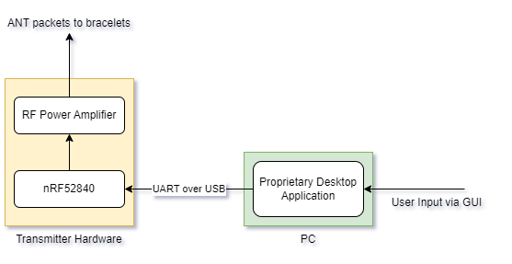
Central Controller Prototype
DMX512
Desktop Application → (USB) → Controller Hardware
Transmits over ANT to bracelets
Notes:
Elijah
Central controller hooks up to desktop over USB and transmits to bracelets over ANT
For our prototype we just a devkit, which consists of a nrf52840 SoC with a front end module to amplify, didn’t do our own prototype circuit for that side

Slide 15
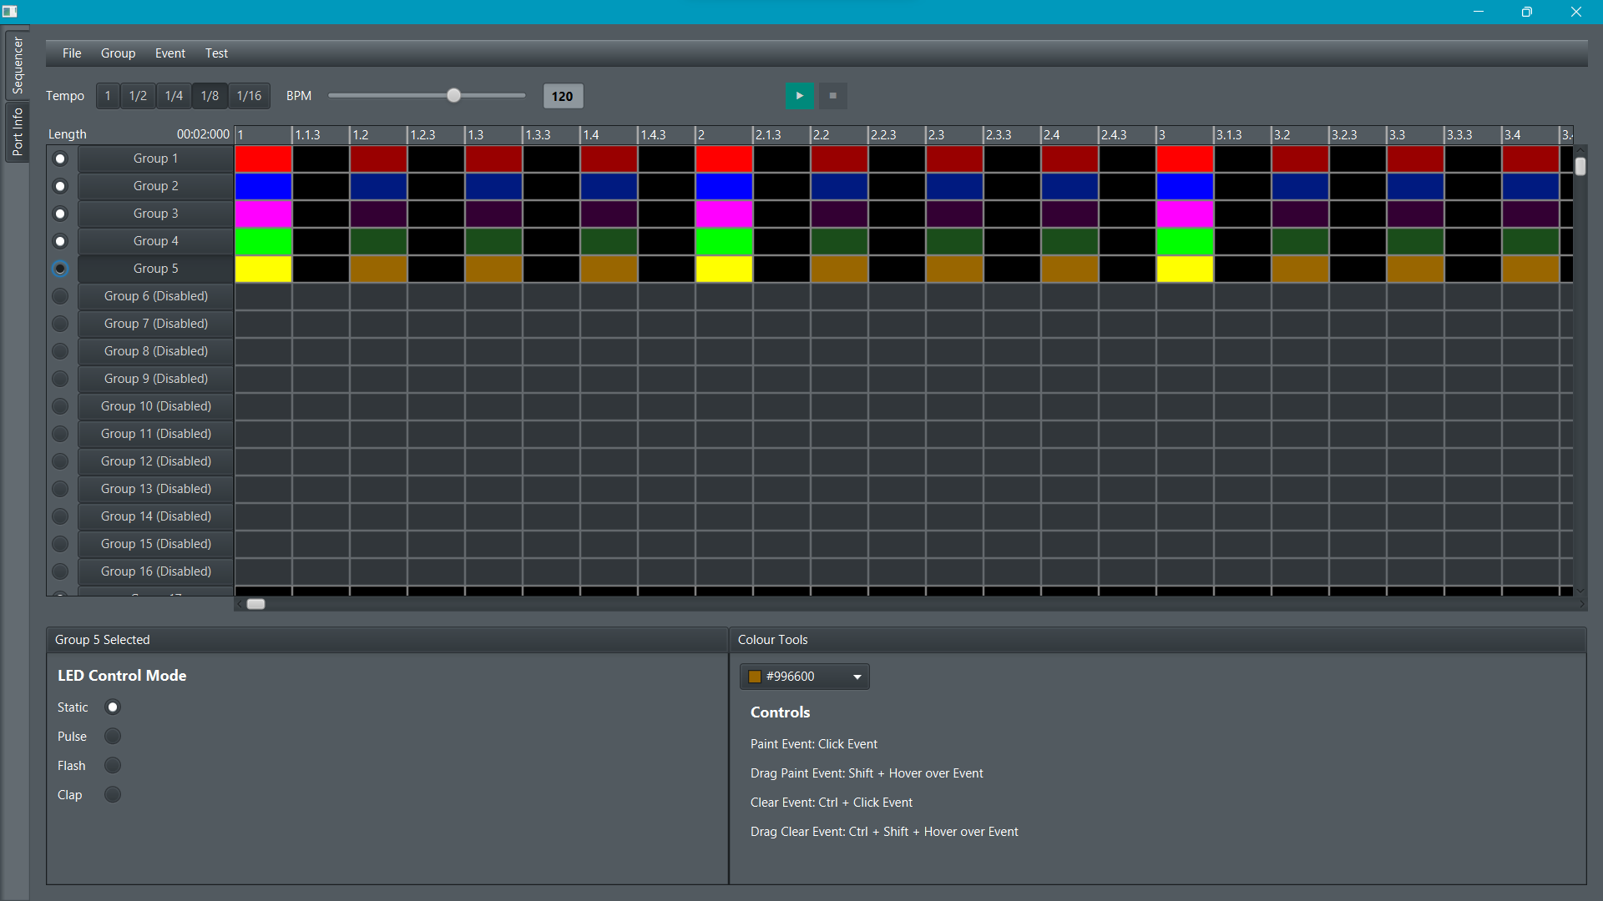
Desktop App
Notes:
Elijah:
Sequence editor where the user can define bracelet groups and events over a configurable timeline
Each row represents a group or section in the crowd
Each column represents a timestamp where a transmission is sent to the enabled groups with the configured colour
Each group of bracelets is synchronised to display the same colour
These sequences can be saved and reused for later

Slide 16
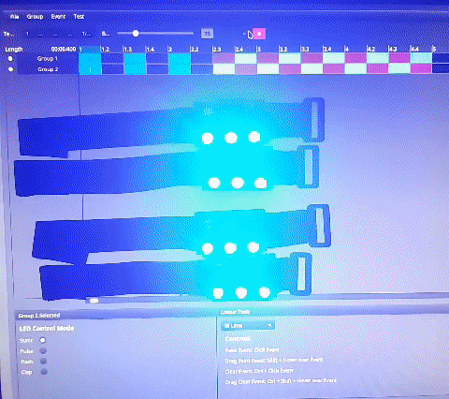
Desktop App | Demo
Notes:
Elijah:

Slide 17
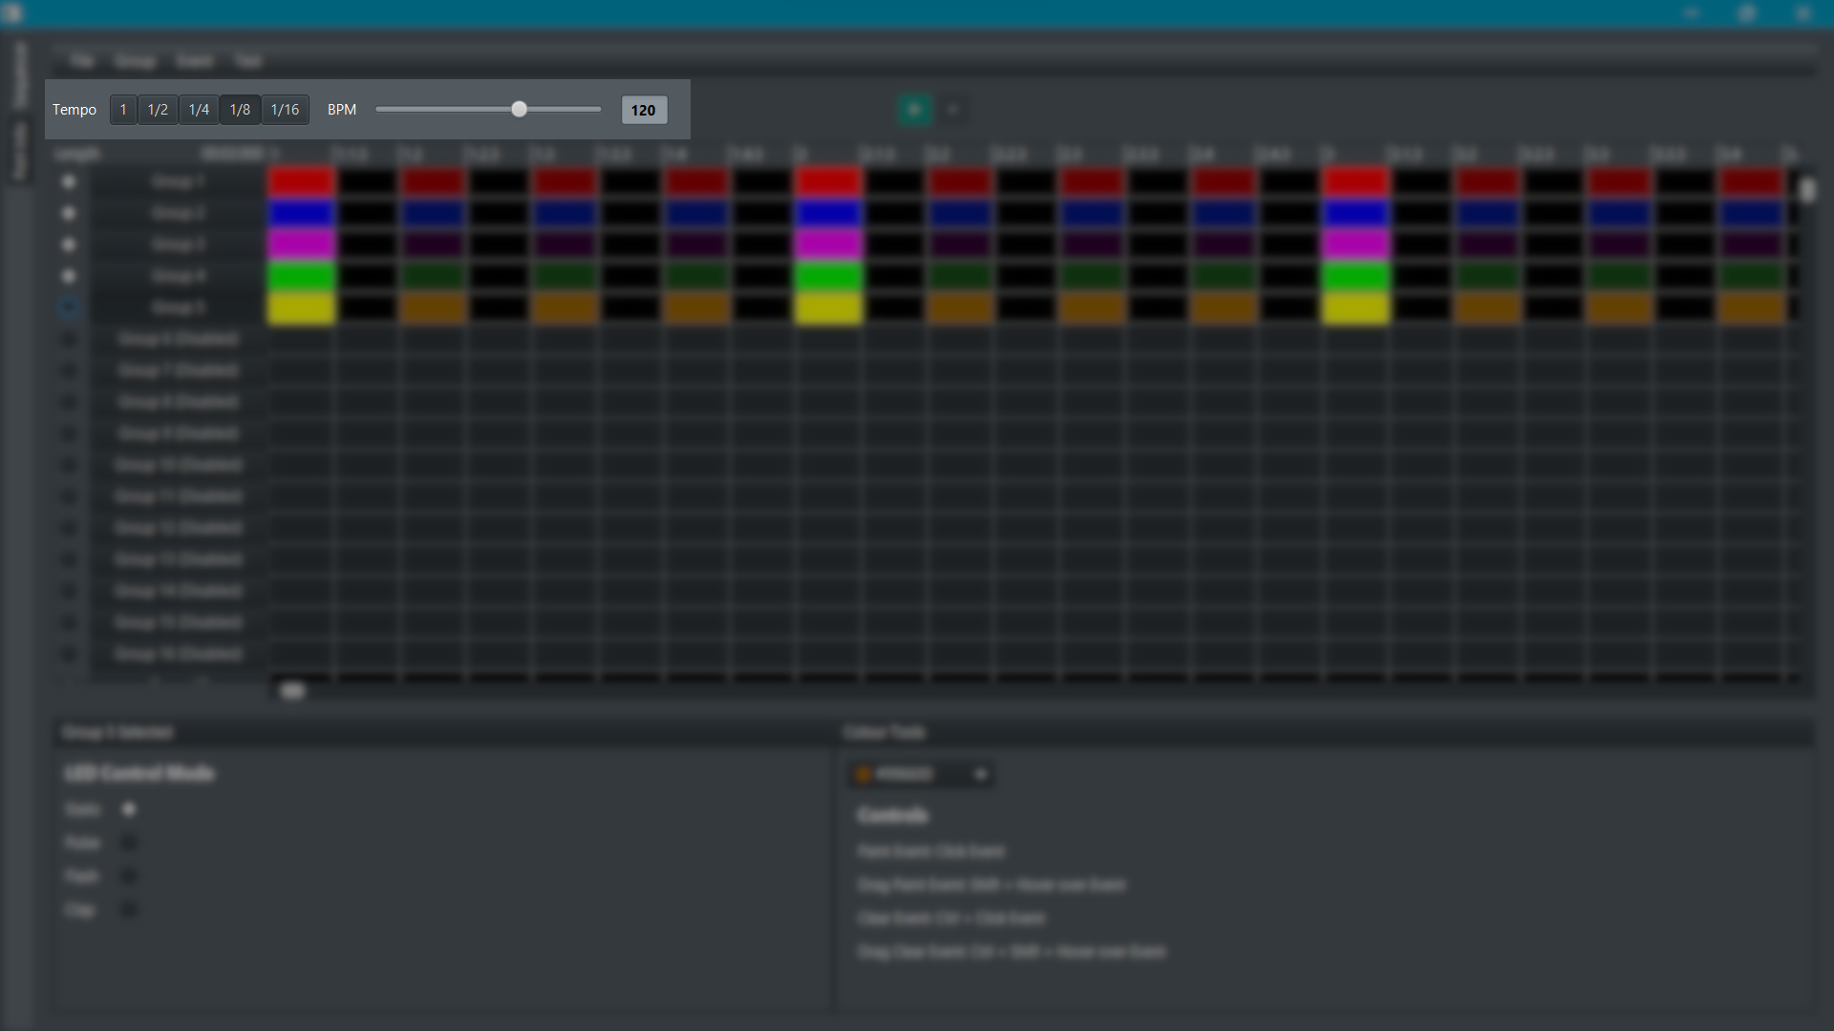
Desktop App | Playback Speed
Notes:
Elijah
Configure the speed of the sequence and the frequency of the events transmitted

Slide 18
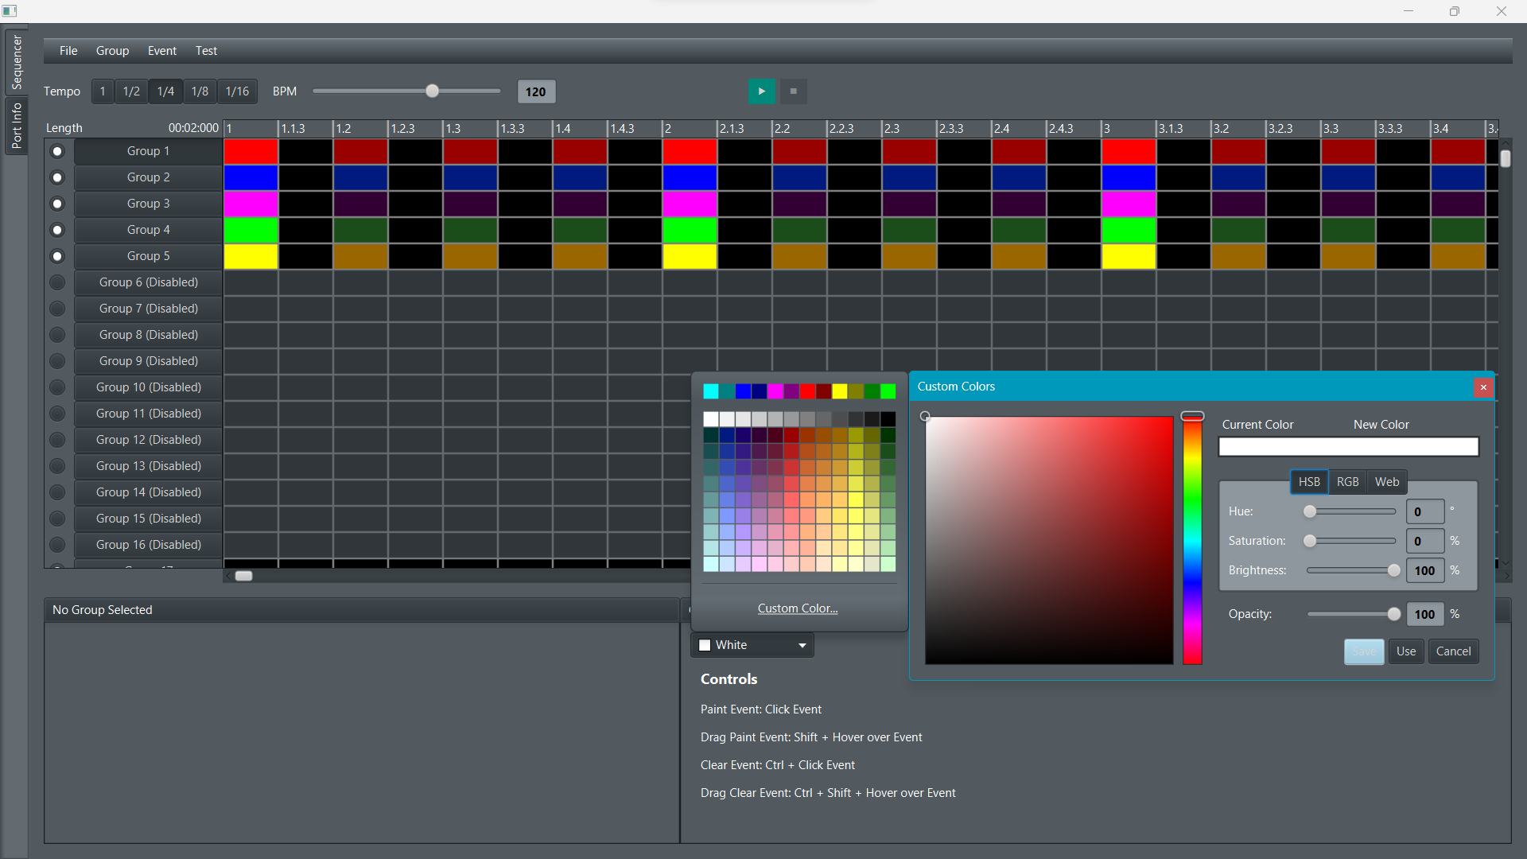
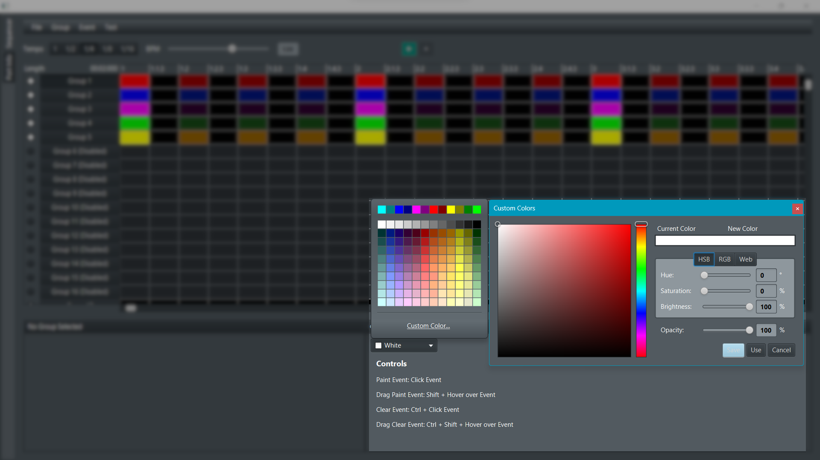
Desktop App | Colour Selector
Notes:
Elijah

Slide 19
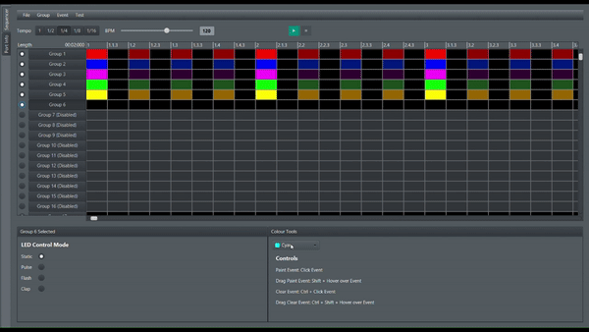
Desktop App | Colour Painting
Notes:
Elijah

Slide 20
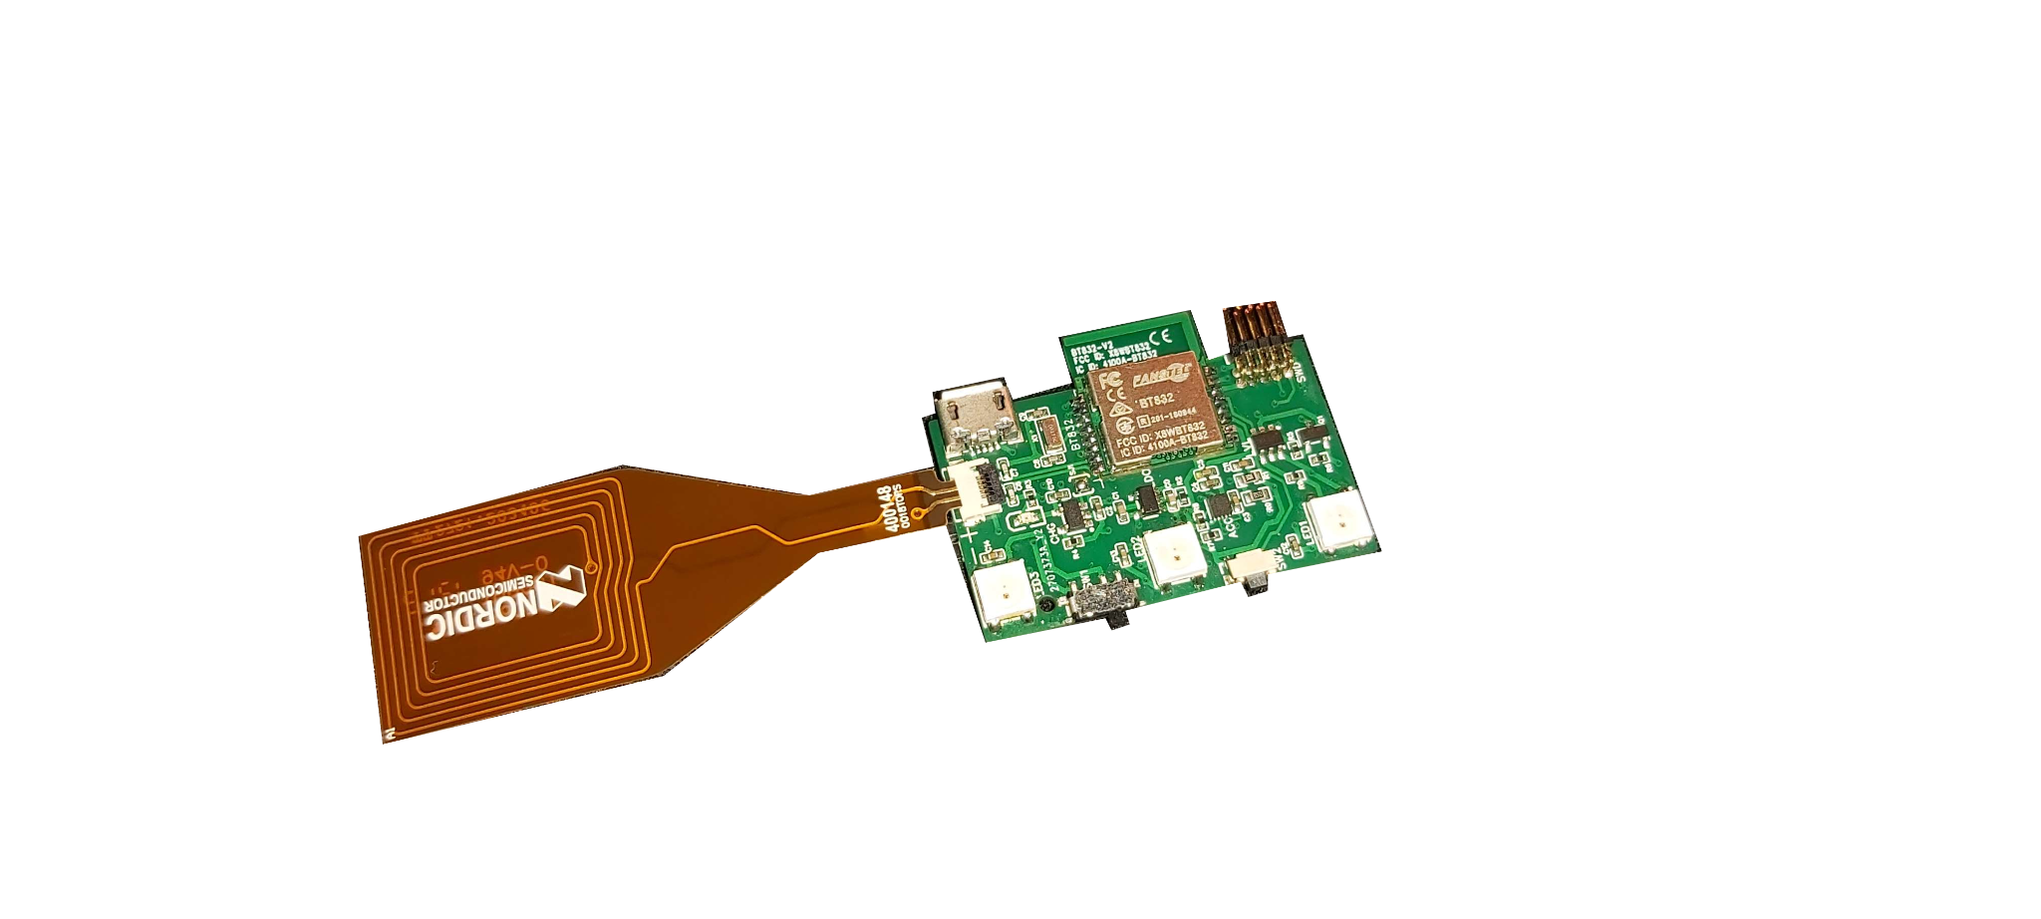
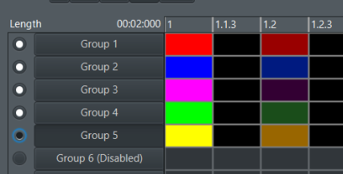
NFC Group Assignment
Notes:
Ethan
NFC on bracelet
Allows the groups in the venue to know which channel to listen to for their own colour settings.
Instead of the venue setting the groups manually, each user can dynamically change their group assignment through an NFC ‘tap’
At the gate could have group assignments that the bracelet would tap to in order to change the group ID.

Slide 21
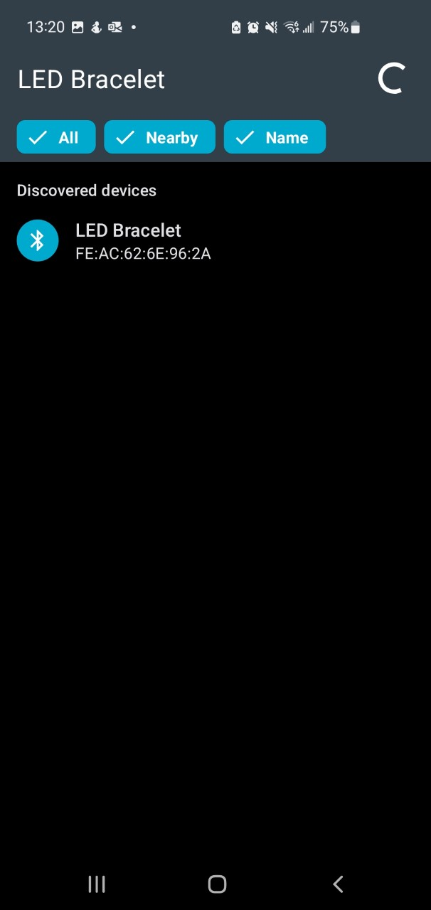
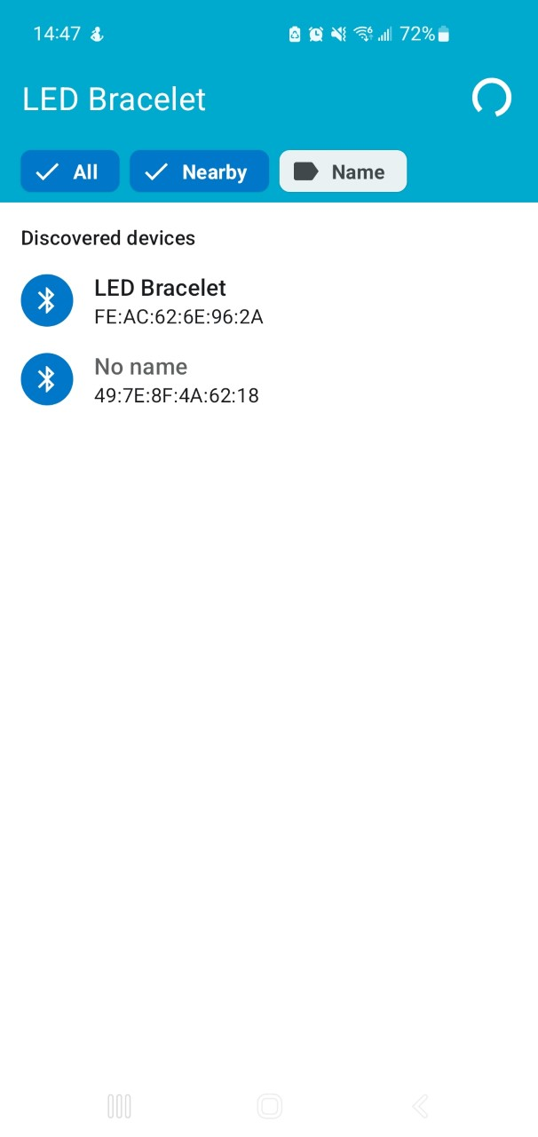
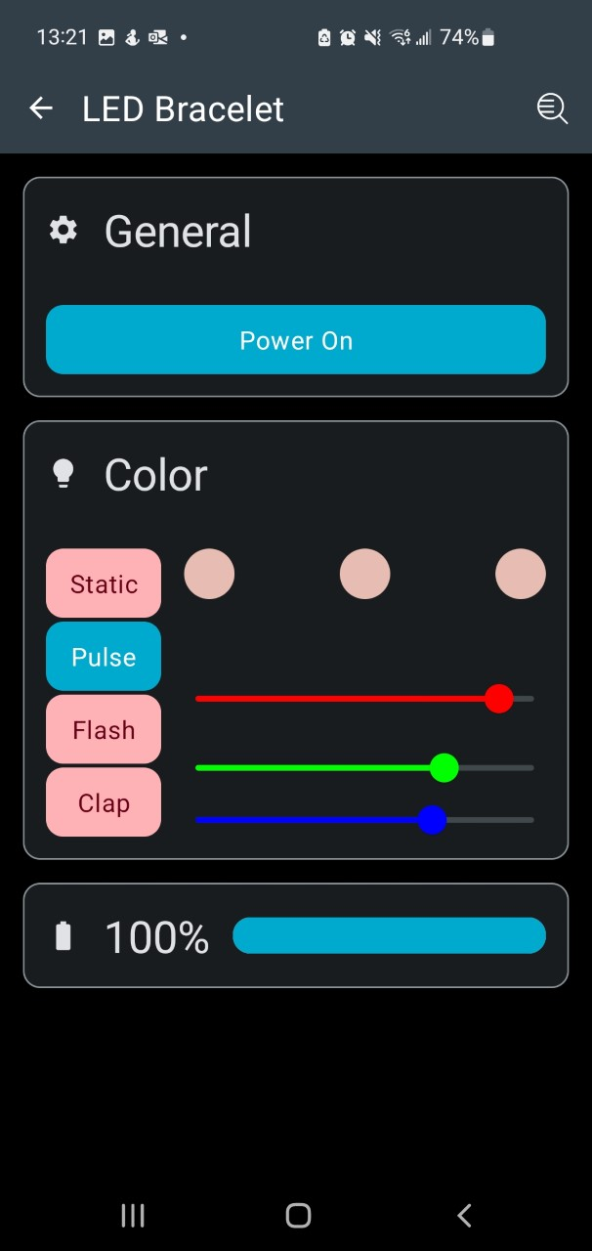
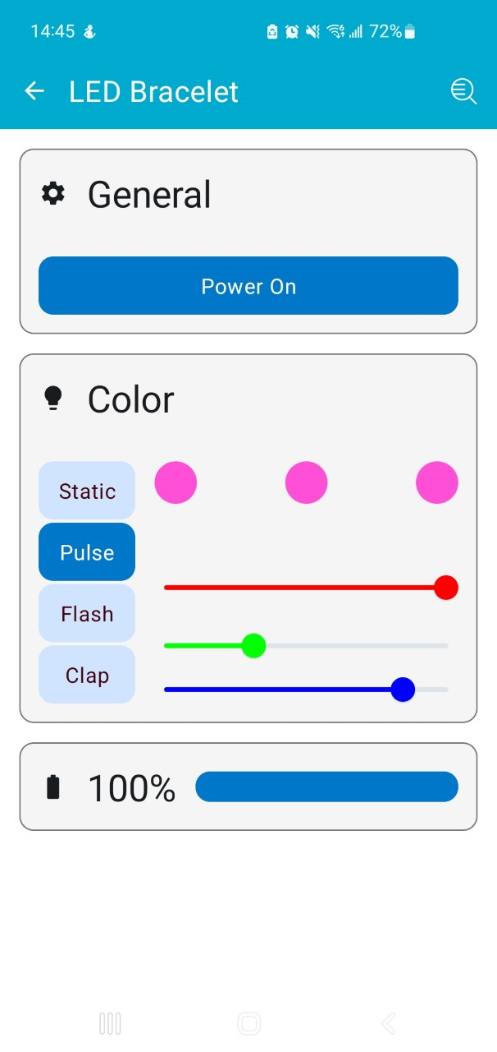

Smartphone App
Notes:
Carter
App for personal use outside venue
Prototype app connects to bracelet over BLE
Connect bracelet to phone
Turn bracelet on/off
Select modes Static: static colour, Fade: fade between colours, Flash: strobe light, Motion: clap effects
Change color
battree life

Slide 22
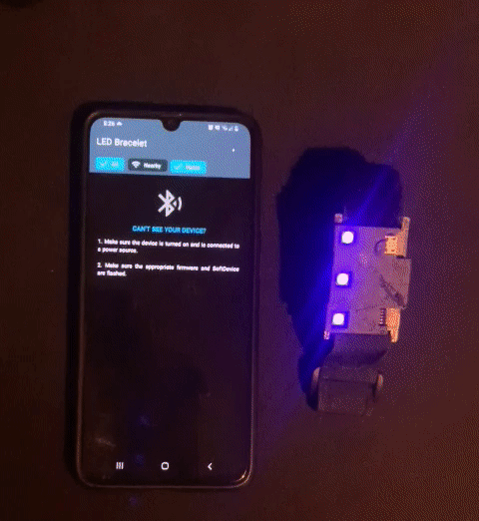
Smartphone App Demo
Notes:
Carter

Slide 23
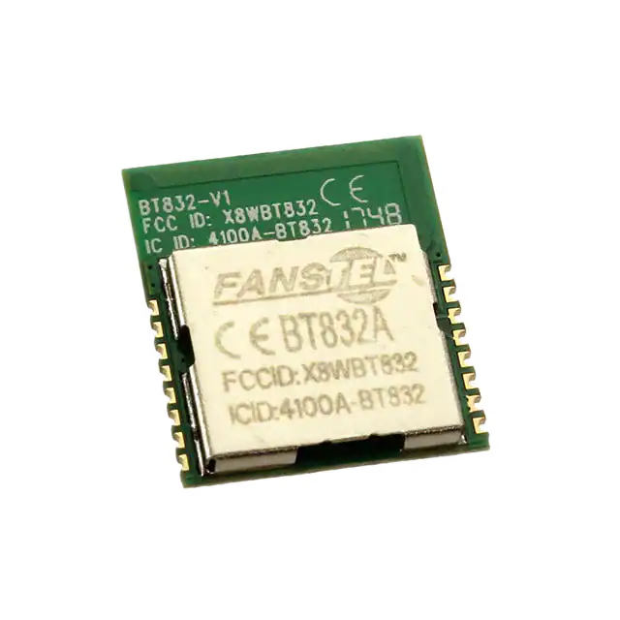
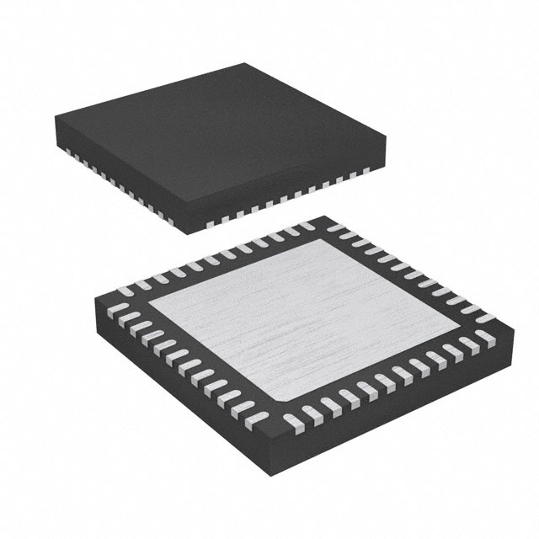
Bracelet Cost Breakdown
TOTAL BOM COST = $13.33 per bracelet
Main Components
nrf52832 Wireless Module: | $7.02
MMA8653FCR1 Accelerometer: | $1.97
Battery Charging IC MCP73812T: | $1.60
Battery: | $1.17
* quotes in CAD for order quantity of 1000 *
Notes:
Carter
Cost of most expensive components: nrf52832 SoC module could be less expensive if using the chip only, which can be found for 2.40. but higher development costs for the rf circuitry
Total cost
We did not estimate the cost of the cases or what the total manufacturing cost would be

Slide 24
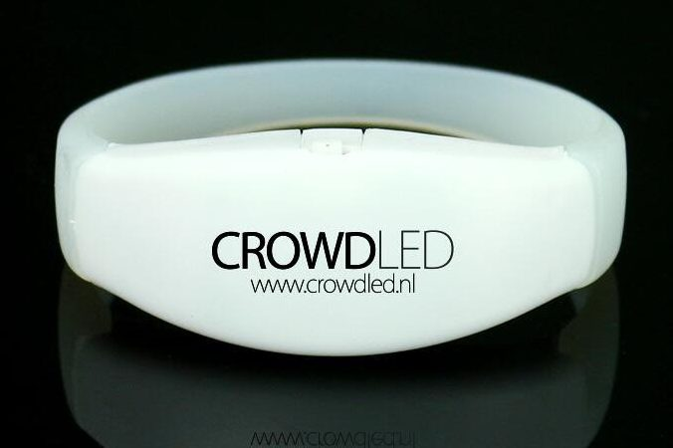
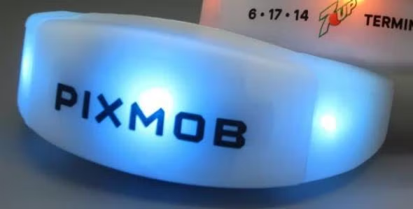
Lessons Learned
Wireless protocol throughput
Bracelet cost savings
Bracelet space savings
Notes:
Hunter
What would we change for next iteration of prototype with more time and resources
experimental ANT protocol throughput little bit lower than listed in the documentation we found, we also found the 10Hz refresh rate to seem somewhat low in practice. in testing use a proprietary 2.4GHz protocol if had more time
Potential cost savings
Potential space savings, competitors have slightly more compact design.
Central controller - DMX512 use industry standard and convert for light
More functionality for NFC concession stands and stuff
More features for outside of concert on app - can do some fun stuff with LEDs + accelerometer bracelet mayb some games 8)

Slide 25
Potential Improvements
Central controller adapter from standard lighting protocols
More NFC functionality
More features outside of concerts!

Slide 26
Questions?
Notes:
Everyone

Slide 27
Wireless protocol selection
ANT is used by central controller to send messages to bracelet over 2.4GHz radio
low power, lightweight
connectionless broadcast supported, bracelet is receive only
enables asymmetrical Tx/Rx
80 frequency channels
SoCs available with built-in ANT and BLE coexistence
Alternative Protocol | Reasoning for not selecting
A Proprietary 2.4GHz Protocol | Additional development time for minimal benefits over ANT.
Zigbee, Bluetooth Mesh | Mesh network adds unnecessary complexity since bracelets have nothing to send.
LoRa | Data rate is too low, latency is too high, connectionless broadcast not supported.
WiFi | Unnecessary complexity for our error tolerant low bandwidth unidirectional application.
Notes:
ANT wireless is the 2.4GHz radio protocol that the controller will be using to send messages to the bracelet
A few reasons why ANT was selected is:
extremely lightweight and low power
it supports a broadcast topology where the bracelet is receive only, which means we can have a high power transmitter in controller, but the transmitter on bracelet is very low power
a large number of frequency channels which gives us the ability to frequency multiplex and increase our data rate
There are SoCs available that have build in ANT and BLE coexistence working out of the box drastically reducing development costs
At the bottom there is a quick over view of some alternative protocols that we considered and our reasoning for not selecting them if you want to look at that later

Slide 28
Full Electronics BOM
Description | Name | Quantity | Unit Price (CAD) 1000 units | total price
Accelerometer | MMA8653FCR1 | 1 | 1.9749 | 1.9749
LiPo Charging IC | MCP73812T-420I/OT | 1 | 1.6027 | 1.6027
NFC antenna conn. | X05A12H05G | 1 | 0.197 | 0.1970
3.3V LDO | TPAP2112K-3.3TRG1 | 1 | 0.1232 | 0.1232
RGB LED | WS2812B-B | 3 | 0.0726 | 0.2178
red LED | KT-0603R | 1 | 0.0031 | 0.0031
logic level shifter | SN74LVC1T45DBVR | 1 | 0.274 | 0.2740
MOSFET | BSS138K | 1 | 0.09288 | 0.0928
Slide switch | SSSS811101 | 1 | 0.1054 | 0.1054
Push button | YTS-A002-2 | 1 | 0.0265 | 0.0265
BLE SoC Module | Msa_BT832_01 | 1 | 7.023 | 7.0230
Micro USB Conn. | 10118193-0001LF | 1 | 0.164 | 0.1640
External LF xtal | 32.768kHz | 1 | 0.3047 | 0.3047
Battery | 452530 310mAh 3.7v | 1 | 1.17 | 1.1700
resistors |  | 10 |  | 0.0061
capacitors |  | 15 |  | 0.0412
 |  |  | Total electronics BOM cost: | 13.32648

Slide 29
SoC Selection
PRODUCT/FAMILY | BLE support | 2. Proprietary 2.4GHz | Built-in NFC | Cost | Devkits/EVB available | FCC certified Modules available
Infineon/Cypress AIROC Series | Yes. | No. | No | ~10CAD at volume for higher end | Yes, readily available at acceptable cost. | Yes, through multiple vendors.
Nordic Semiconductor nRF51/52 Series | Yes.. BLE “softdevices” abstraction layer available for easy hardware agnostic BLE bring-up. Nice suite of development tools | Yes. Examples for proprietary 2.4GHz alongside BLE are available. | Yes. Devkits available with NFC antennas, examples for NFC BLE pairing are available. | ~7CAD at volume for higher end nrf52 series chips. ~3CAD for lower end nrf51 series chips. | Yes, readily available at acceptable cost. | Yes, through multiple vendors.
Silicon Labs EFRBG22/24 Series | Yes. Hardware agnostic BLE stack available. | Yes. | No. | ~8CAD at volume for higher end BG24, ~3CAD for lower end BG22 series | Yes, readily available at acceptable cost. | Yes, but not a lot of options.
Notes:
Evaluated three different families. nRF52 had NFC and best dev kit support. Also enabled us to use ANT simultaneously with BLE. Not a requirement but quite a convenient feature.
For our prototype we determined it was the lowest development cost. Some other chip could be cheaper when purchasing in quantity for final product.

Slide 31
Alternative Selection
 | Bandwidth | Latency | Reliability | Hardware cost | Development Cost | safety, environmental and social considerations
1: Infrared | Adequate | Good | Adequate | Worst | Adequate | Adequate
2: WiFi via smartphone BLE | Good | Worst | Bad | Good | Adequate | Adequate
3a: 2.4GHz RF | Adequate | Good | Adequate | Good | Good | Adequate
3b: Sub-1GHz RF | Adequate | Good | Good | Bad | Bad | Adequate
Good - clear advantage when compared to some other alternatives
Adequate - no clear advantage over alternatives
Bad - clear disadvantage when compared to some other alternatives
Worst - clear worst in this category compared to alternatives
Notes:
High level overview of our alternative selection methods
Here we are analyzing technical performance across three main attributes - bandwidth, latency, and reliability for the wireless connection from controller to bracelet
The infrared solution has the clear disadvantage of hardware costs and the WiFi via smartphone connection raises a lot of concerns about latency
Which leaves 3a and 3b.
sub ghz would likely more reliable than 3a which is 2.4ghz but will require additional hardware on the bracelet which raises the cost and development time substantially.
We selected alternative 3a for our design

Slide 32
Alternative Selection
Infrared
Advantages
Smartphone connection not mandatory at event
Less prone to interference
Disadvantages
Requires line of sight unlike RF solutions
Additional hardware on bracelet
Expensive and complex emitter hardware
potentially out of project scope
WiFi via smartphone connection
Advantages
Can use existing WiFi at venues
Only BLE connection required on bracelet
No proprietary transmitter hardware required
Disadvantages
REQUIRES smartphone connection to be controlled at event
Phones should all be connected to same local network (WiFi) to avoid latency
2.4GHz RF
Advantages
No additional hardware on bracelet
Can leverage different channels/frequencies for group addressing
Many existing protocols to choose from
Disadvantages
Might be prone to interference in an indoor stadium environment
Requires proprietary hardware for transmitter
Sub-1GHz RF
Advantages
Reliable reception
Less interference than 2.4GHz
Better range than 2.4GHz
Disadvantages
Requires additional hardware on bracelet
Requires proprietary hardware for transmitter
Less existing protocols to choose from compared to 2.4GHz

Slide 33
Battery Chemistry Selection
 | Size | Power | Voltage | Cost | Environmental | Safety
1: Lithium Ion | Good | Bad | Adequate | Worst | Adequate | Adequate
*2: Lithium Polymer Pouch | Adequate | Adequate | Adequate | Good | Adequate | Bad
3: Lithium Manganese Dioxide | Bad | Adequate | Bad | Worst | Bad | Adequate
4: Lithium Iron Phosphate | Bad | Adequate | Bad | Adequate | Good | Adequate
Good - clear advantage when compared to some other alternatives
Adequate - no clear advantage over alternatives
Bad - clear disadvantage when compared to some other alternatives
Worst - clear worst in this category compared to alternatives

Slide 34
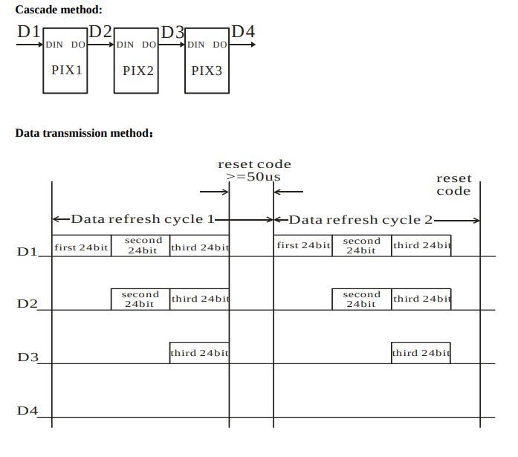
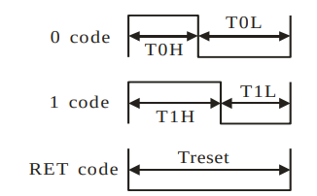
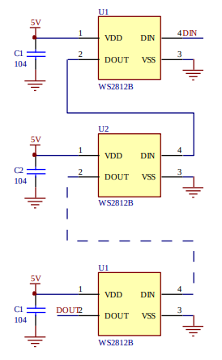
LED Control

